Slide 1
Ramsey Theorem
Luca Archenault

Slide 2
Ramsey Theory
An offshoot of mathematics that uses the appearance of a structure and one or more substructures to prove that a property or characteristic holds
Typically a given mathematical structure is divided into pieces or modified, and the question is asked; How big must the original structure be in order to guarantee that a piece of it holds a specific property
Ex. How many people must be present at a party for at least 3 people to know each other or 3 people to not know each other?

Slide 3
Ramsey Theorem
Theorem:
For all s, t >= 1 there exists an n >= 1 such that every 2-coloring of Kₙ contains a monochromatic shape/clique, or order s or t.
Ramsey Numbers:
The Ramsey numbers, R(s, t) are the smallest numbers of n where the 2-coloring of Kₙ contains a monochromatic shape/clique of order s or t.

Slide 4
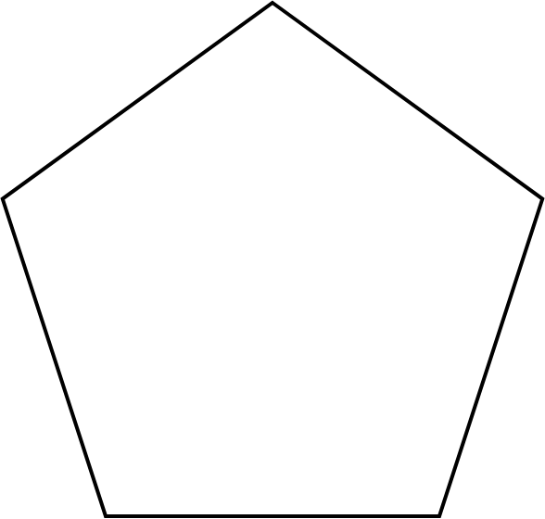
Example- General
How many people must be present at a party for at least 3 people to know each other or 3 people to not know each other?
n- represents the number of vertices of the main shape
s and t- represent the type of subshape that needs to be made up
Notes:
Amount of colors is proportional to amount of properties (here there are 2)

Slide 5
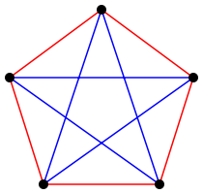
Example-cont.
How many people must be present at a party for at least 3 people to know each other or 3 people to not know each other?
1
When n = 5:
In this case, a singly colored triangle cannot be made. Therefore K₅ does not satisfy
R(3, 3).
5
2
4
3
Notes:
We color it like this so that each vertice receives the same edge color ratio.

Slide 6
Example-cont.
How many people must be present at a party for at least 3 people to know each other or 3 people to not know each other?
When n = 6:
1
2
Can you orient the red/blue edges between the vertices to make this shape contain all multichromatic triangles (while keeping the vertice-red/blue ratio)?
6
3
5
4

Slide 7
Example-cont.
How many people must be present at a party for at least 3 people to know each other or 3 people to not know each other?
2
1
2
More than one monochromatic triangle will be made therefore n = 6 is the solution.
R(3, 3) = 6
6
1
6
3
4
3
5
4
5

Slide 8
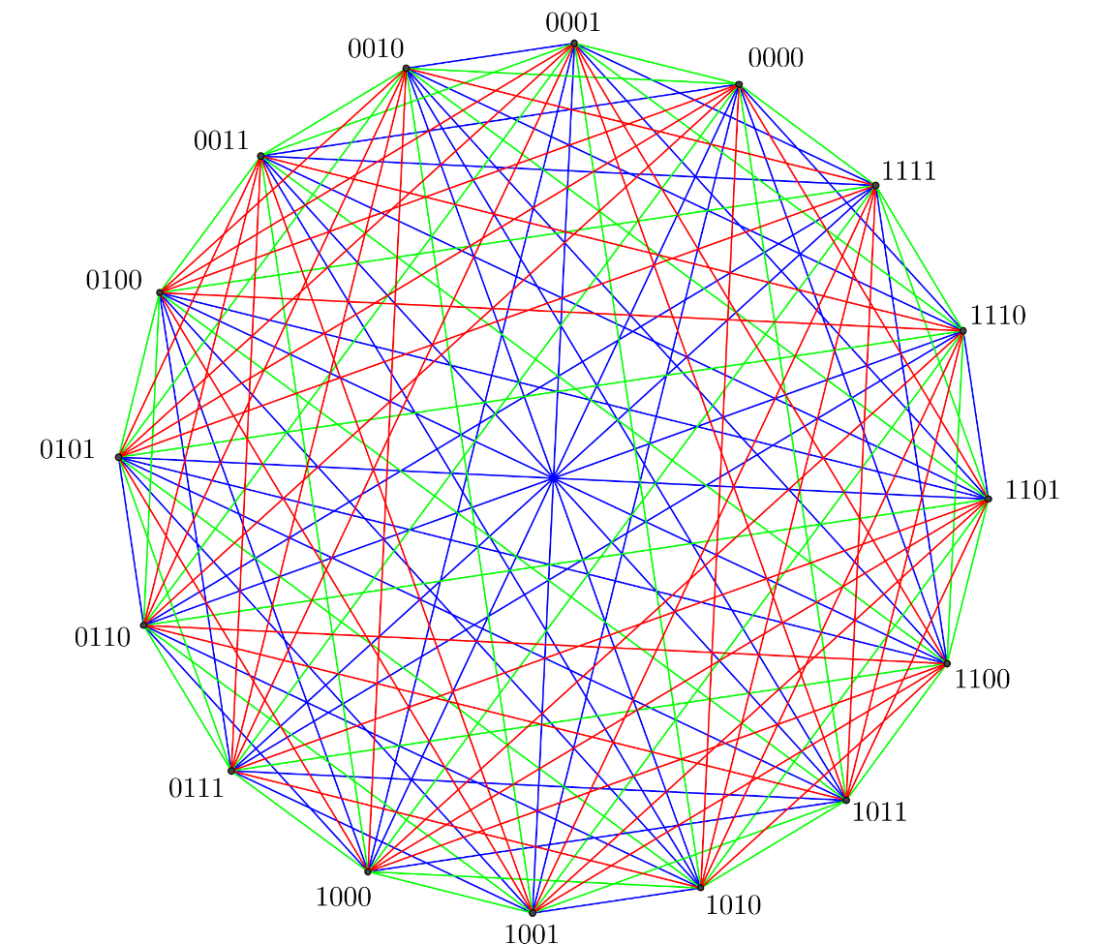
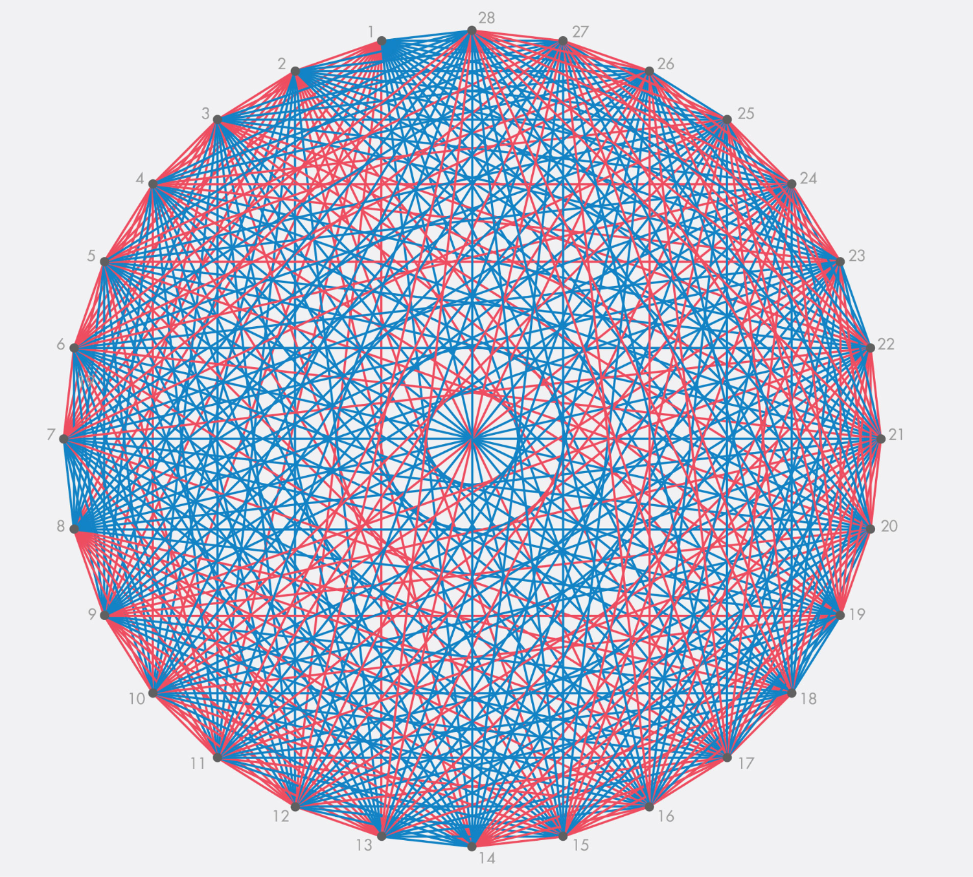
General Theorem
General Theorem:
For any given number of colours, c, and any given integers n₁, ..., n_{c}, there is a number, R(n₁, ..., n_{c}), such that if the edges of a complete graph of order R(n₁, ..., n_{c}) are coloured with c different colours, then for some i between 1 and c, it must contain a complete subgraph of order n_{i} whose edges are all colour i.
*Ramsey numbers are known to be difficult to calculate due to the massive increase in graph complexity, with the increase of c and n_{c}.*
R(3, 3, 3) R(3, 8)

Slide 9
Computational Complexity
Ramsey numbers are known to be difficult to calculate due to the massive increase in graph complexity, with the increase of c and n_{c}.
Imagine an alien force, vastly more powerful than us, lands on Earth and demands the value of R(5, 5) or they will destroy our planet. In this case, we should marshal all our computers and all our mathematicians and attempt to find the value. But suppose, instead, that they ask for R(6, 6). In that case, we should attempt to destroy the aliens.
-Paul Erdős
If brute force were to be used, then an algorithm to find the Ramsey Number of a finite set of integers would be O(c^{n^2}), with c = number of colorings and n = most number of vertices
The best known algorithm exhibits a quadratic growth rate

Slide 10
Work Cited
“Ramsey Theory.” Wikipedia, Wikimedia Foundation, 28 Jan. 2022,
https://en.wikipedia.org/wiki/Ramsey_theory
“Ramsey's Theorem.” Wikipedia, Wikimedia Foundation, 30 Jan. 2022,
https://en.wikipedia.org/wiki/Ramsey%27s_theorem
Rehm, Hunter, director. Ramsey Theory Introduction, Youtube, 6 Jan. 2021,
https://www.youtube.com/watch?v=H6TCPlVP1bI&t=181s. Accessed 14 May 2022.
Weisstein, Eric W. “Ramsey Number.” From Wolfram MathWorld,
https://mathworld.wolfram.com/RamseyNumber.html
Weisstein, Eric W. “Ramsey Theory.” From Wolfram MathWorld,
https://mathworld.wolfram.com/RamseyTheory.html

